Slide 1
Schrodinger Equation in Two- and Three- Dimensions
PC2232 Lecture 12
2D-3D Infinite Wells

Slide 2
Introductory Remarks
We will now extend our square wells to 3 dimensions.
Like its 1D case, the 3D infinite square well is particularly simple and similar in many aspects to the 1D case. As such it allows us to highlight some properties / characteristics of 3D quantum mechanical system which may be obscured in the hydrogen case due to its different geometry and more complex mathematics involved.
As technologies allow us to further reduce in device size to nanometer scales, in particular for semiconductor devices, quantum effects become important. In particular, an understanding of the 3D infinite square wells is needed to describe the quantum dots, and the 2D infinite wells to describe the quantum wires.

Slide 3
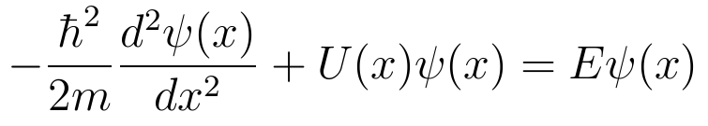
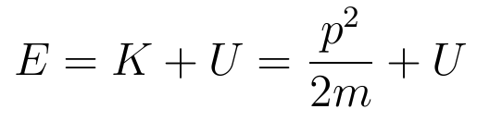
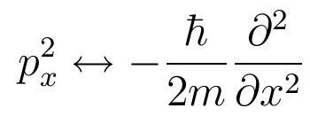
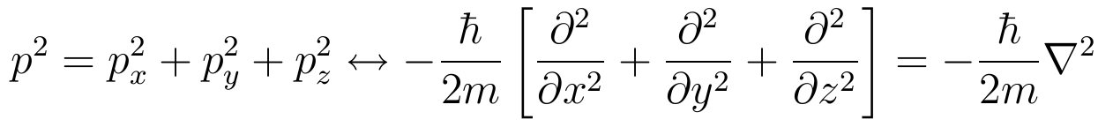
Going into multi-dimensions
The Schrodinger Equation that we have dealt so far is for single dimension (x):
Recall that we “got” the above equation using:
It is not hard to see that in for motion in one dimension (x), we have “substituted” p_{x}² with an operator:
Thus for three dimensions:

Slide 4
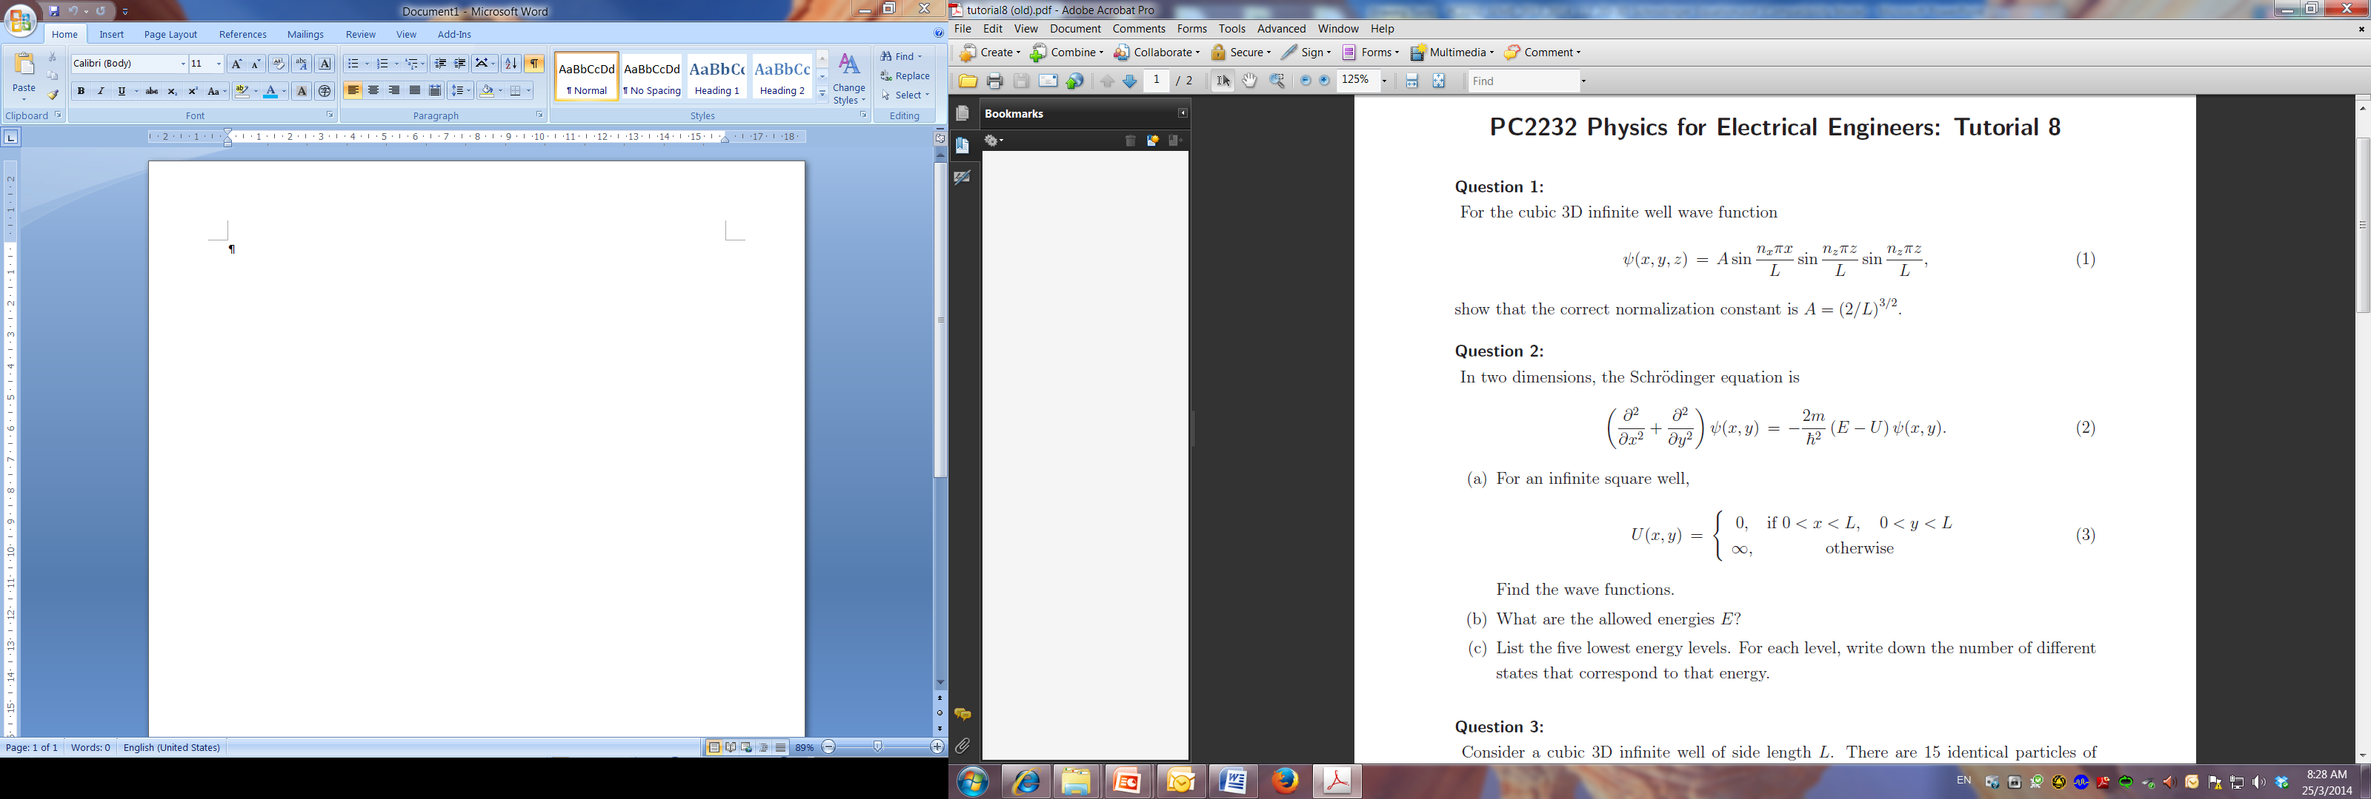
Schrodinger Equations in 2-D
Lets extend our 1D particle in a box another dimension.
Consider a potential well that has dimensions Lx L
Leave this as tutorial problem

Slide 5
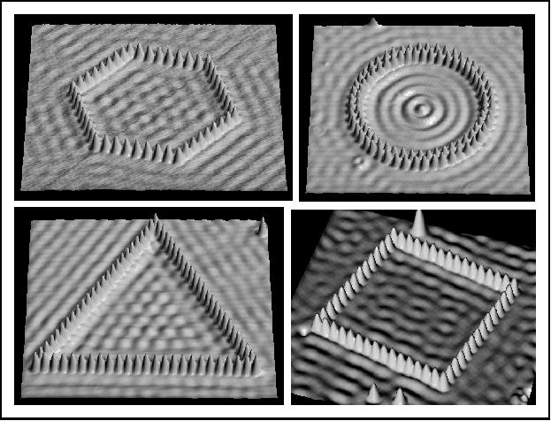
Particle in a 2D box Realization: Quantum Corrals
Don Eigler IBM

Slide 6
Shaping the World Atom by Atom
Particle in a 2D box Realization: Quantum Corrals
Don Eigler IBM

Slide 7
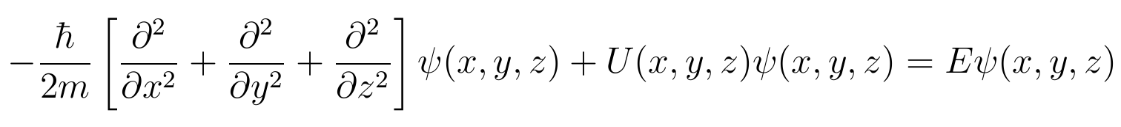
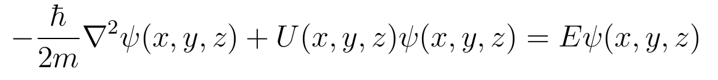
Schrodinger Equations in 3-D
So the Schrodinger Equation in 3-dimension can be written as:
or
where the wave function and the potential energy are now functions of x, y and z.
∇² is the same Laplacian which you have come across in EE2011.
We will deal with two important 3-dimension potentials:
  3-D infinite square wells
  Coulomb potential – the hydrogen atom.

Slide 8
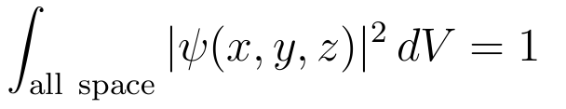
Probability Density & Normalization
In one dimension, |ψ(x)|² is the probability density or probability per unit length so that |ψ(x)|² dx is the probability of finding the particle between x and (x + dx).
Similarly, in 3D, |ψ(x, y, z)|² is the probability density or the probability per unit volume so that |ψ(x, y, z)|² dV is the probability of finding the particle in a small volume dV at (x, y, z).
Dimension of |ψ(x, y, z)| is (volume)^{-1/2} or (length)^{-3/2}.
Again, if ψ(x, y, z) describes a single particle, the total probability of finding it somewhere in three-dimensional space must be 1.
The normalization condition becomes:

Slide 9
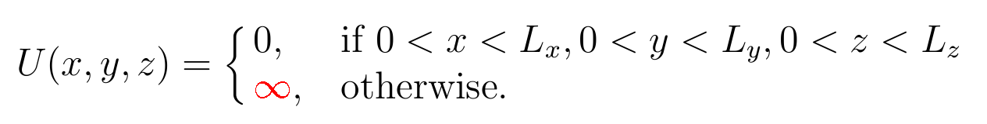
3D Infinite Square Well
This is the simplest 3D bound system and is a good model for the quantum dots.
The particle is bound in a box-shaped region by infinitely “high” walls at x = 0 and L_{x}, y = 0 and L_{y}, z = 0 and L_{z}.
The potential energy is therefore
z
As in the 1D case, the wave function cannot penetrate outside the infinite walls, i.e., ψ(x, y, z) = 0 there , and so we will concentrate on the region inside the box where U = 0.
U = ∞
L_{z}
U = 0
L_{x}
y
L_{y}
x

Slide 10

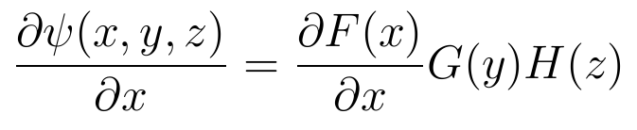
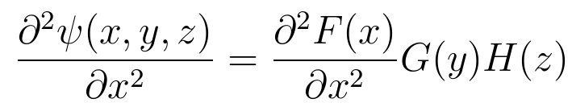
3D Infinite Square Well - Solutions
For a differential equation involving multiple independent variables, our first step is separation of variables.
We assume that the wave function is a product of three functions, each of a different independent variable. Here they are x, y and z. (In the case of hydrogen atom, you will see that they are r, θ and φ.)
z
U = ∞
F(x) is a function of x only and does not depend on y or z. Similarly G(y) is a function of y only and H(z) of z only.
Partial differentiation wrt x gives:
L_{z}
U = 0
L_{x}
y
L_{y}
x

Slide 11
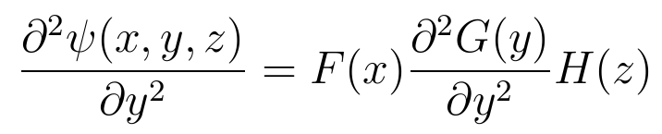
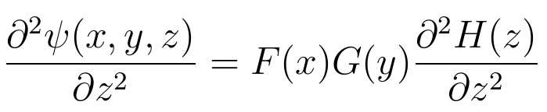
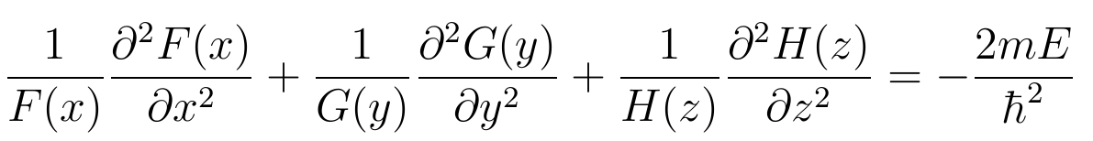
3D Infinite Square Well - Solutions
Similarly, partial differentiation wrt y and z twice gives:
&
In the box, U(x, y, z) = 0 and thus the Schrodinger Equation becomes
Dividing by F(x)G(y)H(z) on both sides:
z
U = ∞
L_{z}
U = 0
Each of the spatial variables is now in a separate term. If the equation holds for x₁, y₁, z₁, it can holds for x₂, y₁, z₁ only if the term involving x (first term) does not vary with x!
L_{x}
y
L_{y}
x

Slide 12
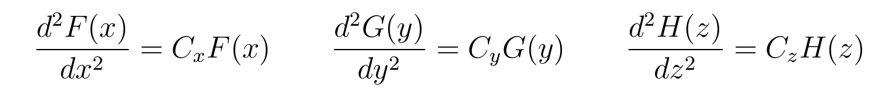
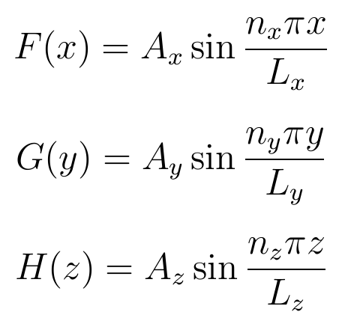
3D Infinite Square Well - Solutions
Thus each term on the LHS must be a constant, say C_{x}, C_{y} and C_{z} respective (of course C_{x}, C_{y} and C_{z} need not have the same value). So we can write three different equations:
z
These are the same equations for the 1D infinite square wells (with C_{x}, C_{y} and C_{z} being negative). The solutions are
U = ∞
L_{z}
U = 0
L_{x}
y
L_{y}
x

Slide 13
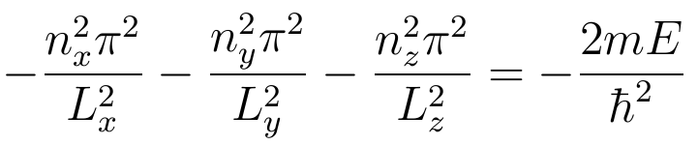
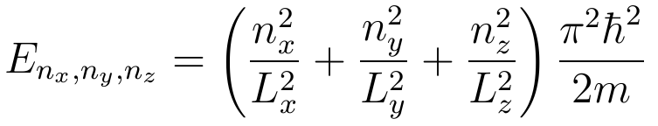
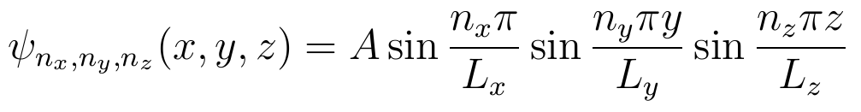
3D Infinite Square Well - Solutions
Note that each dimension is independent and so the constants n and L need not be the same. Substitute the solutions into:
z
U = ∞
L_{z}
And denoting A_{x}A_{y}A_{z} by A, wave function is
U = 0
L_{x}
y
L_{y}
x

Slide 14
Quantization & Quantum numbers
We note that the boundary conditions in each dimension lead to energy quantization according to the value of a single quantum number. Imposing boundary conditions in three dimensions naturally leads to three quantum numbers – here n_{x}, n_{y} and n_{z}.
This is true in general: For each dimension, there is an independent quantum number.
The three quantum numbers take only positive integers, i.e.,
None of the quantum numbers can take the value of 0 – otherwise the whole wave function is 0.
Each set of quantum number (n_{x}, n_{y}, n_{z}) yield unique wave function – a unique three-dimensional standing wave.

Slide 15
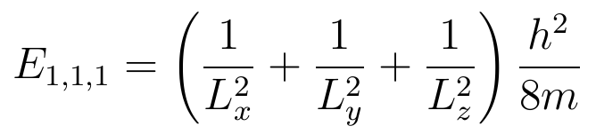
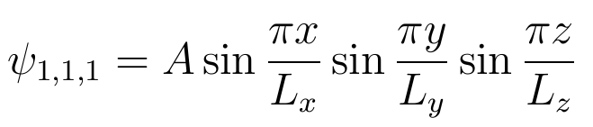
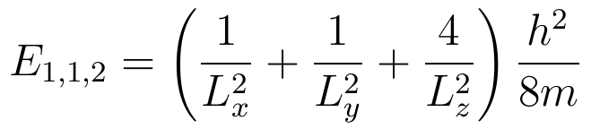
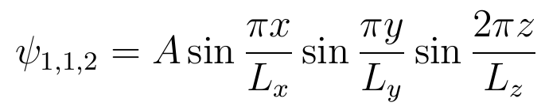
States of the 3D Infinite Well
It is obvious that the state with the lowest energy is (n_{x}, n_{y}, n_{z}) = (1,1,1) regardless of the value of L_{x}, L_{y} and L_{z}.
The ground state energy and wave function are:
The next higher energy state depends on the relative values of L_{x}, L_{y} and L_{z}. For example if L_{x} < L_{y} < L_{z}, then the next higher energy state given by (n_{x}, n_{y}, n_{z}) = (1,1,2), with energy and wave function
&

Slide 16

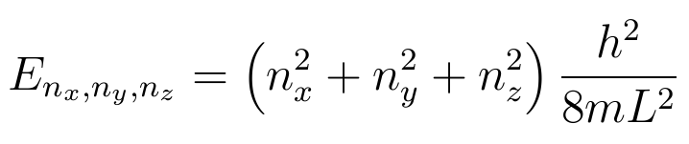
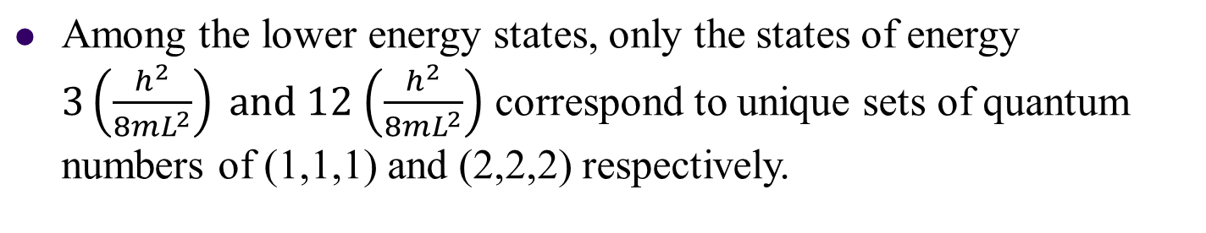
Degeneracy
An idea crucial to many applications in our real 3D world is that multiple states can have the same energy and the number of equal-energy states increases with the symmetry of the system.
Suppose the box is as symmetric as possible – a cube where:
Then the energy of (n_{x}, n_{y}, n_{z})-state becomes

Slide 17
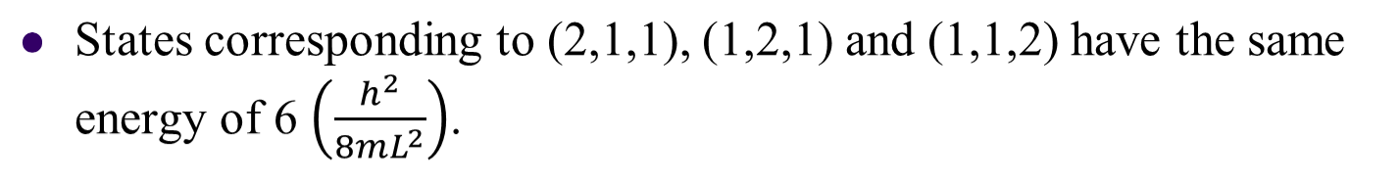
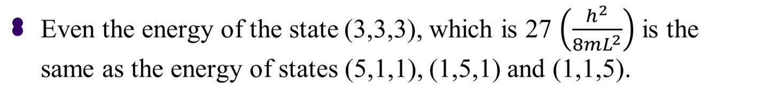
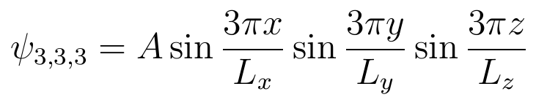
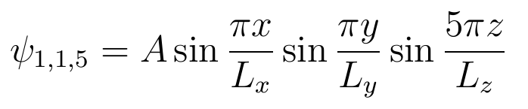
Degeneracy
These states though have the same energy, have very different wave functions, e.g.,
The coincidence – that different wave functions have the same energy – is called degeneracy. The energy levels for such states are said to be degenerate.

Slide 18
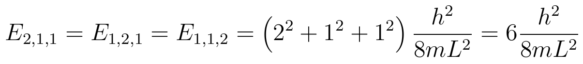
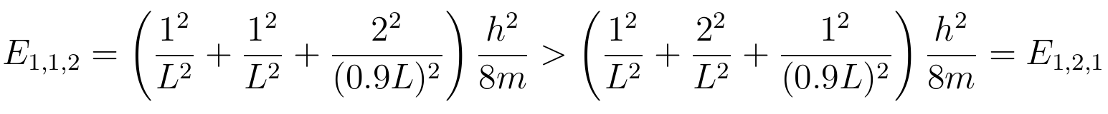
Splitting of Energy Levels
Degeneracy results from symmetry. For example, if we have L_{x} = L_{y} = L but L_{z} = 0.9 L instead of the original cube, some of the symmetry would be lost, and the result is the splitting of formerly degenerate energy levels.
Take the states corresponding (2,1,1), (1,2,1) and (1,1,2). In the original cube (L_{x} = L_{y} = L_{z} = L) ,
For case where L_{z} = 0.9 L:

Slide 19


Splitting of Energy Levels
Thus
We can represent the splitting of energy levels in an energy diagram below. Many discoveries of atomic physics have sprung from observations of slight splitting among levels previously thought to be equal.
E
1,1,2
2,1,1
1,2,1
splitting
2,1,1
1,2,1
1,1,2
1,1,1
1,1,1

Slide 20
Free particles in a 3D Box
What if the 3D box has different dimensions at each axis?
L_{z}
L_{y}
L_{x}
h
n_{x}
n_{y}
n_{z}
2
π
2
2
2
2
E=
( + + )
L_{x}
L_{y}
L_{z}
2m
2
2
2

